Slide 1
E R MODEL
Unit 2 Day 7

Slide 2
General Guideline
© (2021) ABES Engineering College.
This document contains valuable confidential and proprietary information of ABESEC. Such confidential and proprietary information includes, amongst others, proprietary intellectual property which can be legally protected and commercialized. Such information is furnished herein for training purposes only. Except with the express prior written permission of ABESEC, this document and the information contained herein may not be published, disclosed, or used for any other purpose.

Slide 3
Module Objective
To describe, use and apply data analysis and modelling technique i.e., E R Modelling
To apply the types of Binary Relationship Constraints
To describe the fundamental elements of E R Model
To understand the concept of keys
To explain the extended E R concepts
To convert the E R Model to relational tables, populate relational database

Slide 4
Topics Covered
Day 5
Day 6
Day 7
Day 8
Introduction Case Study-User Requirement
Basic Concept of ER Model
ER Modelling
Entities
Attributes
Relationship
Constraints on Binary Relationship Types
Keys
Extended ER Concept
Reduction of an E R Model to Relational tables (Cont.)
Complete Relational Model of Case Study
Completion of E R Diagram-– College Case Study

Slide 5
Session Plan - Day 7
Completion of ER Diagram – College Case Study
Identify Entity
Decide relationships and cardinality
Draw Entities and relationships separately
Connect relationships and entities

Slide 6
Completion of E-R Diagram

Slide 7
Case Study – College Management System
The primary purpose of this case study is to design a database to construct a student information management system in the department of student affairs – ABESEC.
It is to transform the work in this department from manually to a computer-based system, which leads to providing accuracy, efficiency, security, and so on.
User Requirement: The required information for the college management system that is collected from the college employees are as follows:
Student information
Faculty Information
Course information
Other information

Slide 8
Case Study – College Management System
The employee has shared the below-mentioned requirement story:
In a College, there are several departments, and each department has one head of the department (HOD). Department has a name, its location, and students that belong to the department. A student can belong to only one department, and a department can have many students. If a department has recently come into existence, it might not have any students. Students have roll number, name, date of birth, gender, hobby, phone number, and address. Faculty has a name, designation, date of joining, gender & salary and belongs to a particular department.
A department can run many courses with assigned credits, and students can study any number of courses being offered by various departments. There are sections within each department, and each section has many students. Each section has its name, maximum capacity of that section, and the number of students in that section. Students need to do one mini-project individually.

Slide 9
Case Study – College Management System
Story continues as:
Each available mini-project has to be chosen based on its name, domain, subject, and description. Faculty members can teach multiple courses in multiple departments. One course can be taught by many faculty members across departments. Faculty members can be part of multiple research projects. These projects are either sponsored by the government, industry, or the college itself. The faculty member can do one or more projects, and one project can have more than one faculty member. Research projects have a fixed duration, and their status needs to be tracked regularly.

Slide 10
Case Study – College Management System (Cont.)
After collecting the user requirement, just go through the entire story again and then break the requirement story into well-defined parts to understand the requirements in a better way.
In a College,
There are several departments, and each department has many faculties.
Out of the faculties from each department, one faculty is acting as Head of Department.
Department has a name, Id, phone extension, specific mailing address, and Students that belong to the department.
Students can belong to only one department at a time.
Department can have more than one or no student.
Students have their name, unique identification number, address, age, gender, hobbies, and other information.
Faculty also have information similar to Students except for hobbies.
A student studies different Courses. defined parts to understand the requirements in a better way.

Slide 11
Case Study – College Management System (Cont.)
A department can run many courses, and a course can run in many departments.
Faculty teaches these Courses. Faculty can teach more than one course.
Department can run many sections.
Many students can be in one section, and each section has its name and the max capacity.
A student must do one mini-project, and one mini-project can be opted by one student only.
Faculty members can teach in multiple Departments.
Each course can be taught by many faculty members or no one.
Faculty members are also working on multiple research projects.
Research projects are either sponsored by the government, industry, or the college itself.
One project can have more than one faculty member, and one faculty member can work on more than one project.

Slide 12

ERD Designing STEPS
Draw the ERD
Connect relationships and entities
Draw entities and relationships separately
Decide relationships and cardinality
Identify the entity

Slide 13
Can you answer ?​
Q1)What are the steps in designing an ERD for a DBMS?
A) Decide relationships and cardinality, Identify entity, Draw entities and relationships separately, Connect relationships and entities
B)Identify entity, Decide relationships and cardinality, Draw entities and relationships separately, Connect relationships and entities
C) Draw entities and relationships separately, Decide relationships and cardinality, Identify entity, Connect relationships and entities
D) Connect relationships and entities, Draw entities and relationships separately, Decide relationships and cardinality, Identify entity

Slide 14
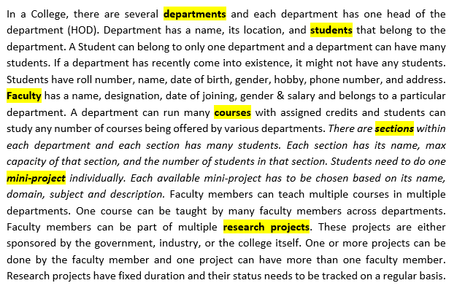
Identify Entity
Identifying nouns in
the story:

Slide 15
Can you answer ?
Q. Find 4 entities in the mentioned case study:
A small accounting firm wants a simple HR application that will help it to keep track of its employees, their positions, allowances, salary scales, and which company vehicles their employees drive. The application must keep track of all the positions at the firm, the employees filling these positions, the allowances for these positions, the salary scales for these positions, and the company vehicles assigned to these positions.
ANS:
Employees , positions , allowances, salary scales
Notes:
Ref: Six-Step Relational Database Design™

Slide 16
Can you answer ?
Q. Find the entities in the mentioned case study:
The International Language School is a language training school.
It offers language classes for corporate clients, which can be conducted at the School or at the offices of the client as they prefer. The School employs teachers, each of whom may teach multiple courses.
The school has clients, each of whom may offer multiple courses via the school. Clients offer courses to their employees, who have the option to participate.
Each course is offered by one client. Each course has one teacher at any given time.
Participants in the courses are employees of the client companies, i.e. they work for the client companies. Each participant can be employed by one company at a time. Participants may be enrolled in more than one course.
ANS:
Clients ,office locations, teachers, courses, participants
Notes:
Ref: https://towardsdatascience.com/designing-a-relational-database-and-creating-an-entity-relationship-diagram-89c1c19320b2
Just looking at the first paragraph of our requirements document we can see clients, office locations, teachers, and courses as possible entities for our database. The rest of the document gives us various pieces of information about the relationships between these entities, and also mentions participants (employees of the clients, but from the point of view of the school, these are participants in the language courses).

Slide 17
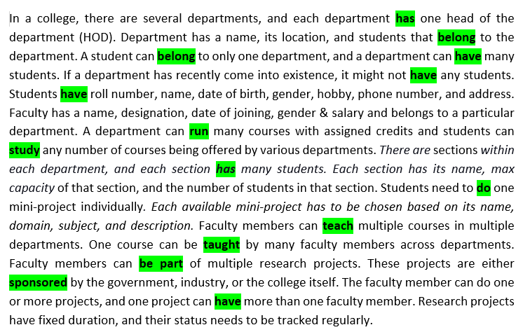
Identify Relationships
Identifying verbs in
the story:

Slide 18
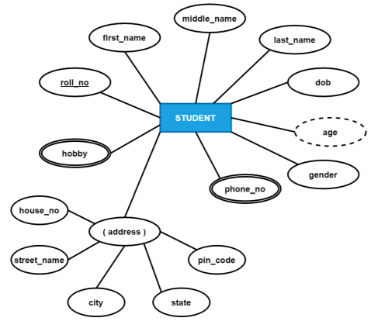
Draw Entities and attributes
a. A student has a roll number, first name, middle name, last name, date of birth, hobby, gender, phone numbers, and address.
STUDENT entity type and its attributes

Slide 19
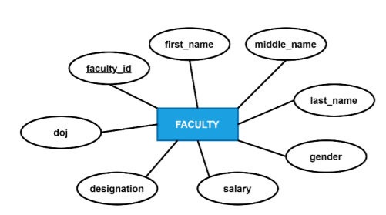
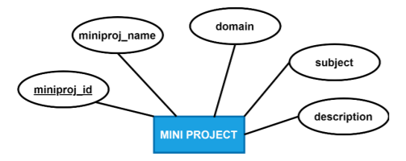
Draw Entities and attributes (contd.)
Faculty has faculty id, first name, middle name, last name, gender, date of joining, designation, and salary.
Mini project has project id, project name, domain subject and description.
FACULTY entity type and its attributes
MINI PROJECT entity type and its attributes

Slide 20
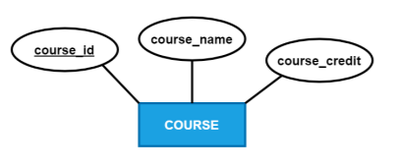
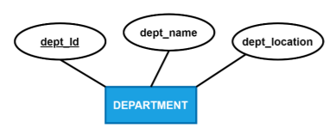
Draw Entities and attributes (contd.)
Course has course id, course name &
course credit.
Department has department id, department name, and department location
COURSE entity type and its attributes
DEPARTMENT entity type and its attributes

Slide 21
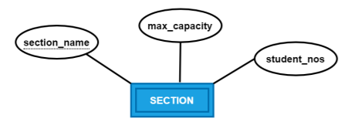
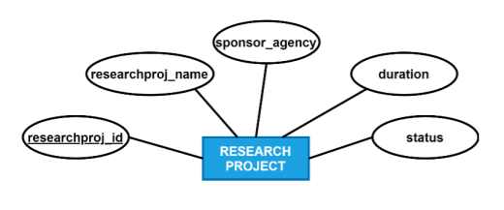
Draw Entities & Attributes (Cont.)
Research Project has research project id, research project name, sponsoring agency duration, and status.
Section has name, max capacity and the number of students in that section.
RESEARCH PROJECT entity type and its attributes
SECTION entity type and its attributes

Slide 22

Connect relationship and entities
Statement- A faculty can teach zero or more courses and course can be taught by zero or more faculty.
Relationship- Teaches , Cardinality- M : N
Participation- Partial for FACULTY entity type (a new faculty might not have been allocated a course yet) and Partial for COURSE entity type (a new course has not been opted by any faculty yet).
Representation of partial relationship between FACULTY and COURSE

Slide 23

Connect relationship and entities
Statement –A student belongs to one department, and a department can have zero or more students
Relationship- Belongs To , Cardinality- M : 1
Participation- Total for STUDENT entity type (a student has to belong to a department to exist) and Partial for DEPARTMENT entity type (a new department might not have any student yet).
Representation of Strong and Partial relationship between STUDENT and DEPARTMENT

Slide 24

Connect relationship and entities (Contd.)
Statement – A department can have zero or more sections; a section must belong to a department. SECTION is a weak entity type as it does not have any prime attribute. The same section name can exist in all departments. Therefore the relationship between department and section is an identifying relationship. A section is identified by it’s department.
Relationship- Has (Identifying Relationship) , Cardinality- 1 : M
Participation- Partial for DEPARTMENT entity type (a new department might not have sections created yet) and Total for SECTION entity type (section has no existence without department).
Representation of Partial and Total relationship between SECTION and DEPARTMENT

Slide 25
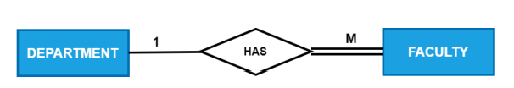
Connect relationship and entities (Contd.)
Statement- A department can have zero or more faculty. Every faculty must be part of only one department.
Relationship- Has , Cardinality- 1 : M
Participation- Partial for DEPARTMENT entity type (a new department might not have any faculty yet) and Total for FACULTY entity type (a faculty has to belong to a department to exist).
Representation of Total and Partial relationship between FACULTY and DEPARTMENT

Slide 26
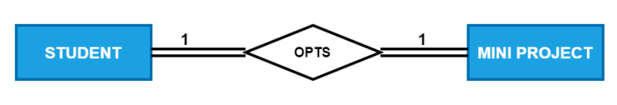
Connect relationship and entities (Contd.)
Statement- Each student has to do one mini project individually and every available miniproject has to be opted by a student.
Relationship- Opts , Cardinality- 1 : 1
Participation- Total for STUDENT entity type (a student has to opt a mini-project) and Total for MINI PROJECT entity type (a mini project has to be opted by a student).
Representation of Total relationship between STUDENT and MINI PROJECT

Slide 27
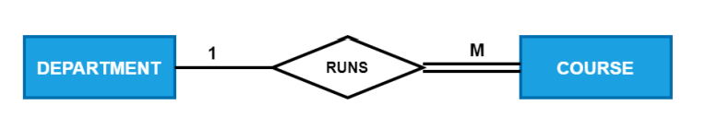
Connect relationship and entities (Contd.)
Statement- A department can run zero or more courses, and each course must belong to only one department.
Relationship- Runs , Cardinality- 1 : M
Participation- Partial for DEPARTMENT entity type (a new department might not be running any course yet) and Total for COURSE entity type (a course has to belong to a department to exist).
Representation of Total and Partial relationship between COURSE and DEPARTMENT

Slide 28

Connect relationship and entities (Contd.)
Statement– A section can have zero or more students, and each student must belong to any one section.
Relationship- Seated In , Cardinality- M : 1
Participation- Total for STUDENT entity type (student has to be seated in a section) and Partial for SECTION entity type (a new section might not have been allocated a student yet).
Representation of Total and Partial relationship between STUDENT and SECTION

Slide 29

Connect relationship and entities (Contd.)
Statement– Each student studies one or more courses as part of the curriculum, and each course can be opted by zero or more students.
Relationship- Studies , Cardinality- M : N
Participation- Total for STUDENT entity type (a student has to study a course) and Partial for COURSE entity type (a new course might not have been opted by a student yet).
Representation of Total and Partial relationship between STUDENT and COURSE

Slide 30
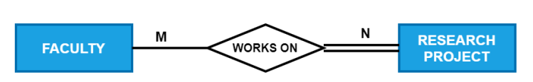
Connect relationship and entities (Contd.)
Statement- A faculty may work on many research projects, and each research must have one or more faculty are working on it.
Relationship- Works On , Cardinality- M : N
Participation- Partial for FACULTY entity type (a faculty may work on a research project) and Total for RESEARCH PROJECT entity type (each research project needs to have faculty working on it).
Representation of Total and Partial relationship between FACULTY and RESEARCH PROJECT

Slide 31
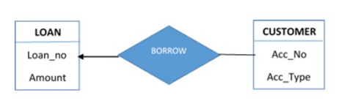
Q. What is the cardinality of relation between LOAN and CUSTOMER in the given diagram
A) A LAON can be borrowed by at most 1 CUSTOMER and a CUSTOMER can borrow atmost 1 LOAN.
B) A LOAN can be borrowed by N CUSTOMERs and a CUSTOMER can borrow atmost 1 LOAN.
C) A LOAN can be borrowed by at most 1 CUSTOMER and a CUSTOMER can borrow N LOANs.
D) LOAN can be borrowed by N CUSTOMERs and a CUSTOMER can borrow a N LOANs.

Slide 32
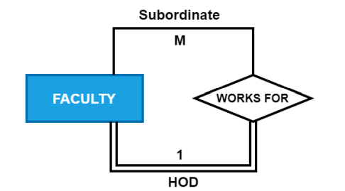
Connect relationship and entities (Contd.)
Statement- Faculty will have a HOD who is a faculty himself/herself. A HOD can have one or more faculty under him/her.
Relationship- Works For , Cardinality- M : 1
Participation- Total for HOD Role (HOD will have faculty under him/her) and Partial for Subordinate Role (The faculty who is a HOD will not have a HOD for him/her).
Representation of Total and Partial in FACULTY relationship as different Role

Slide 33
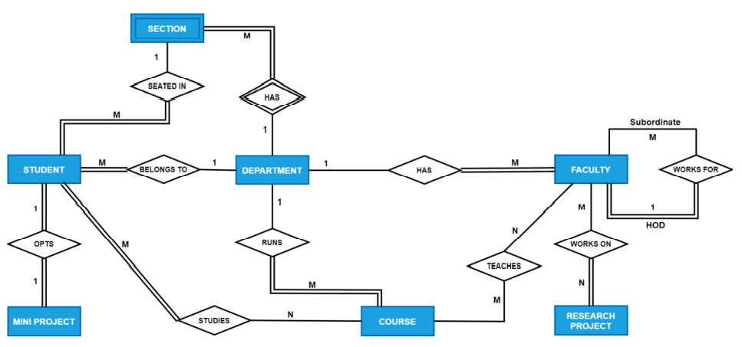
Complete ER Diagram
Complete ER diagram of Case Study

Slide 35
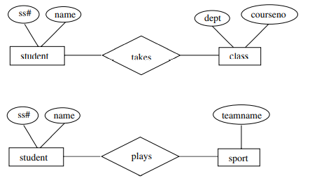
Can you answer this question
Consider an E-R diagram in which the same entity set appears several times. Why is allowing this redundancy a bad practice that one should avoid whenever possible?
Answer: By using one entity set many times we are missing relationships in the model. For example, in the E-R diagram in Figure the students taking classes are the same students who are athletes, but this model will not show that

Slide 36
Thank You

